Slide 1
Aama BITES (FOOD ORDERING AND DELIVERY PORTAL/ APP)
Innovation Project-2021

Slide 2
Team mebers:
Ass. Prof. Attiya Waris-University of Nairobi: waris@uonbi.ac.ke
Dr. Margaret kariuki- University of Nairobi: magmuth@uonbi.ac.ke
Prof. Adeku Salihu Ohiani- University Of Lagos: sadeku@unilag.edu.ng
Dr. Anne Achieng Aseey- University of Nairobi:aassey@uonbi.ac.ke
Arch. Margaret Njoroge-Team leader (University of Nairobi)- mmweru@uonbi.ac.ke

Slide 3
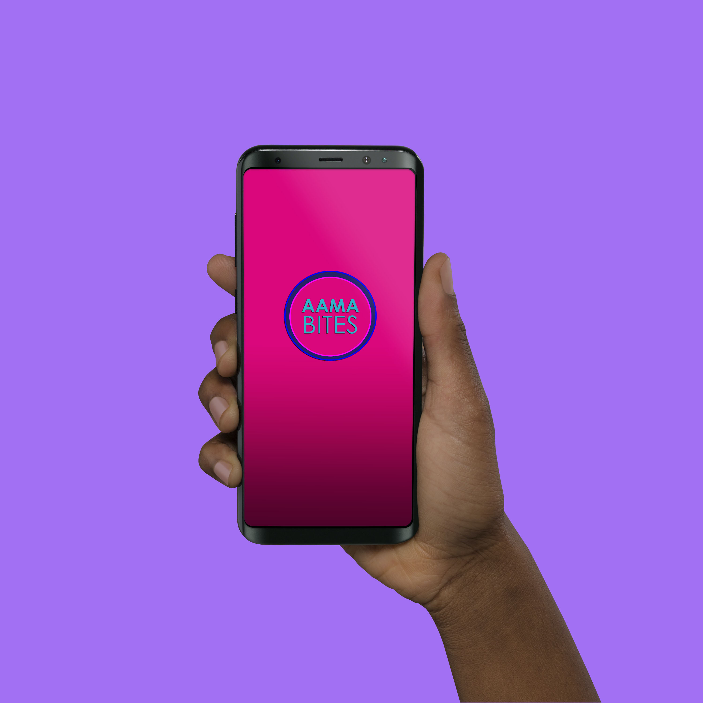
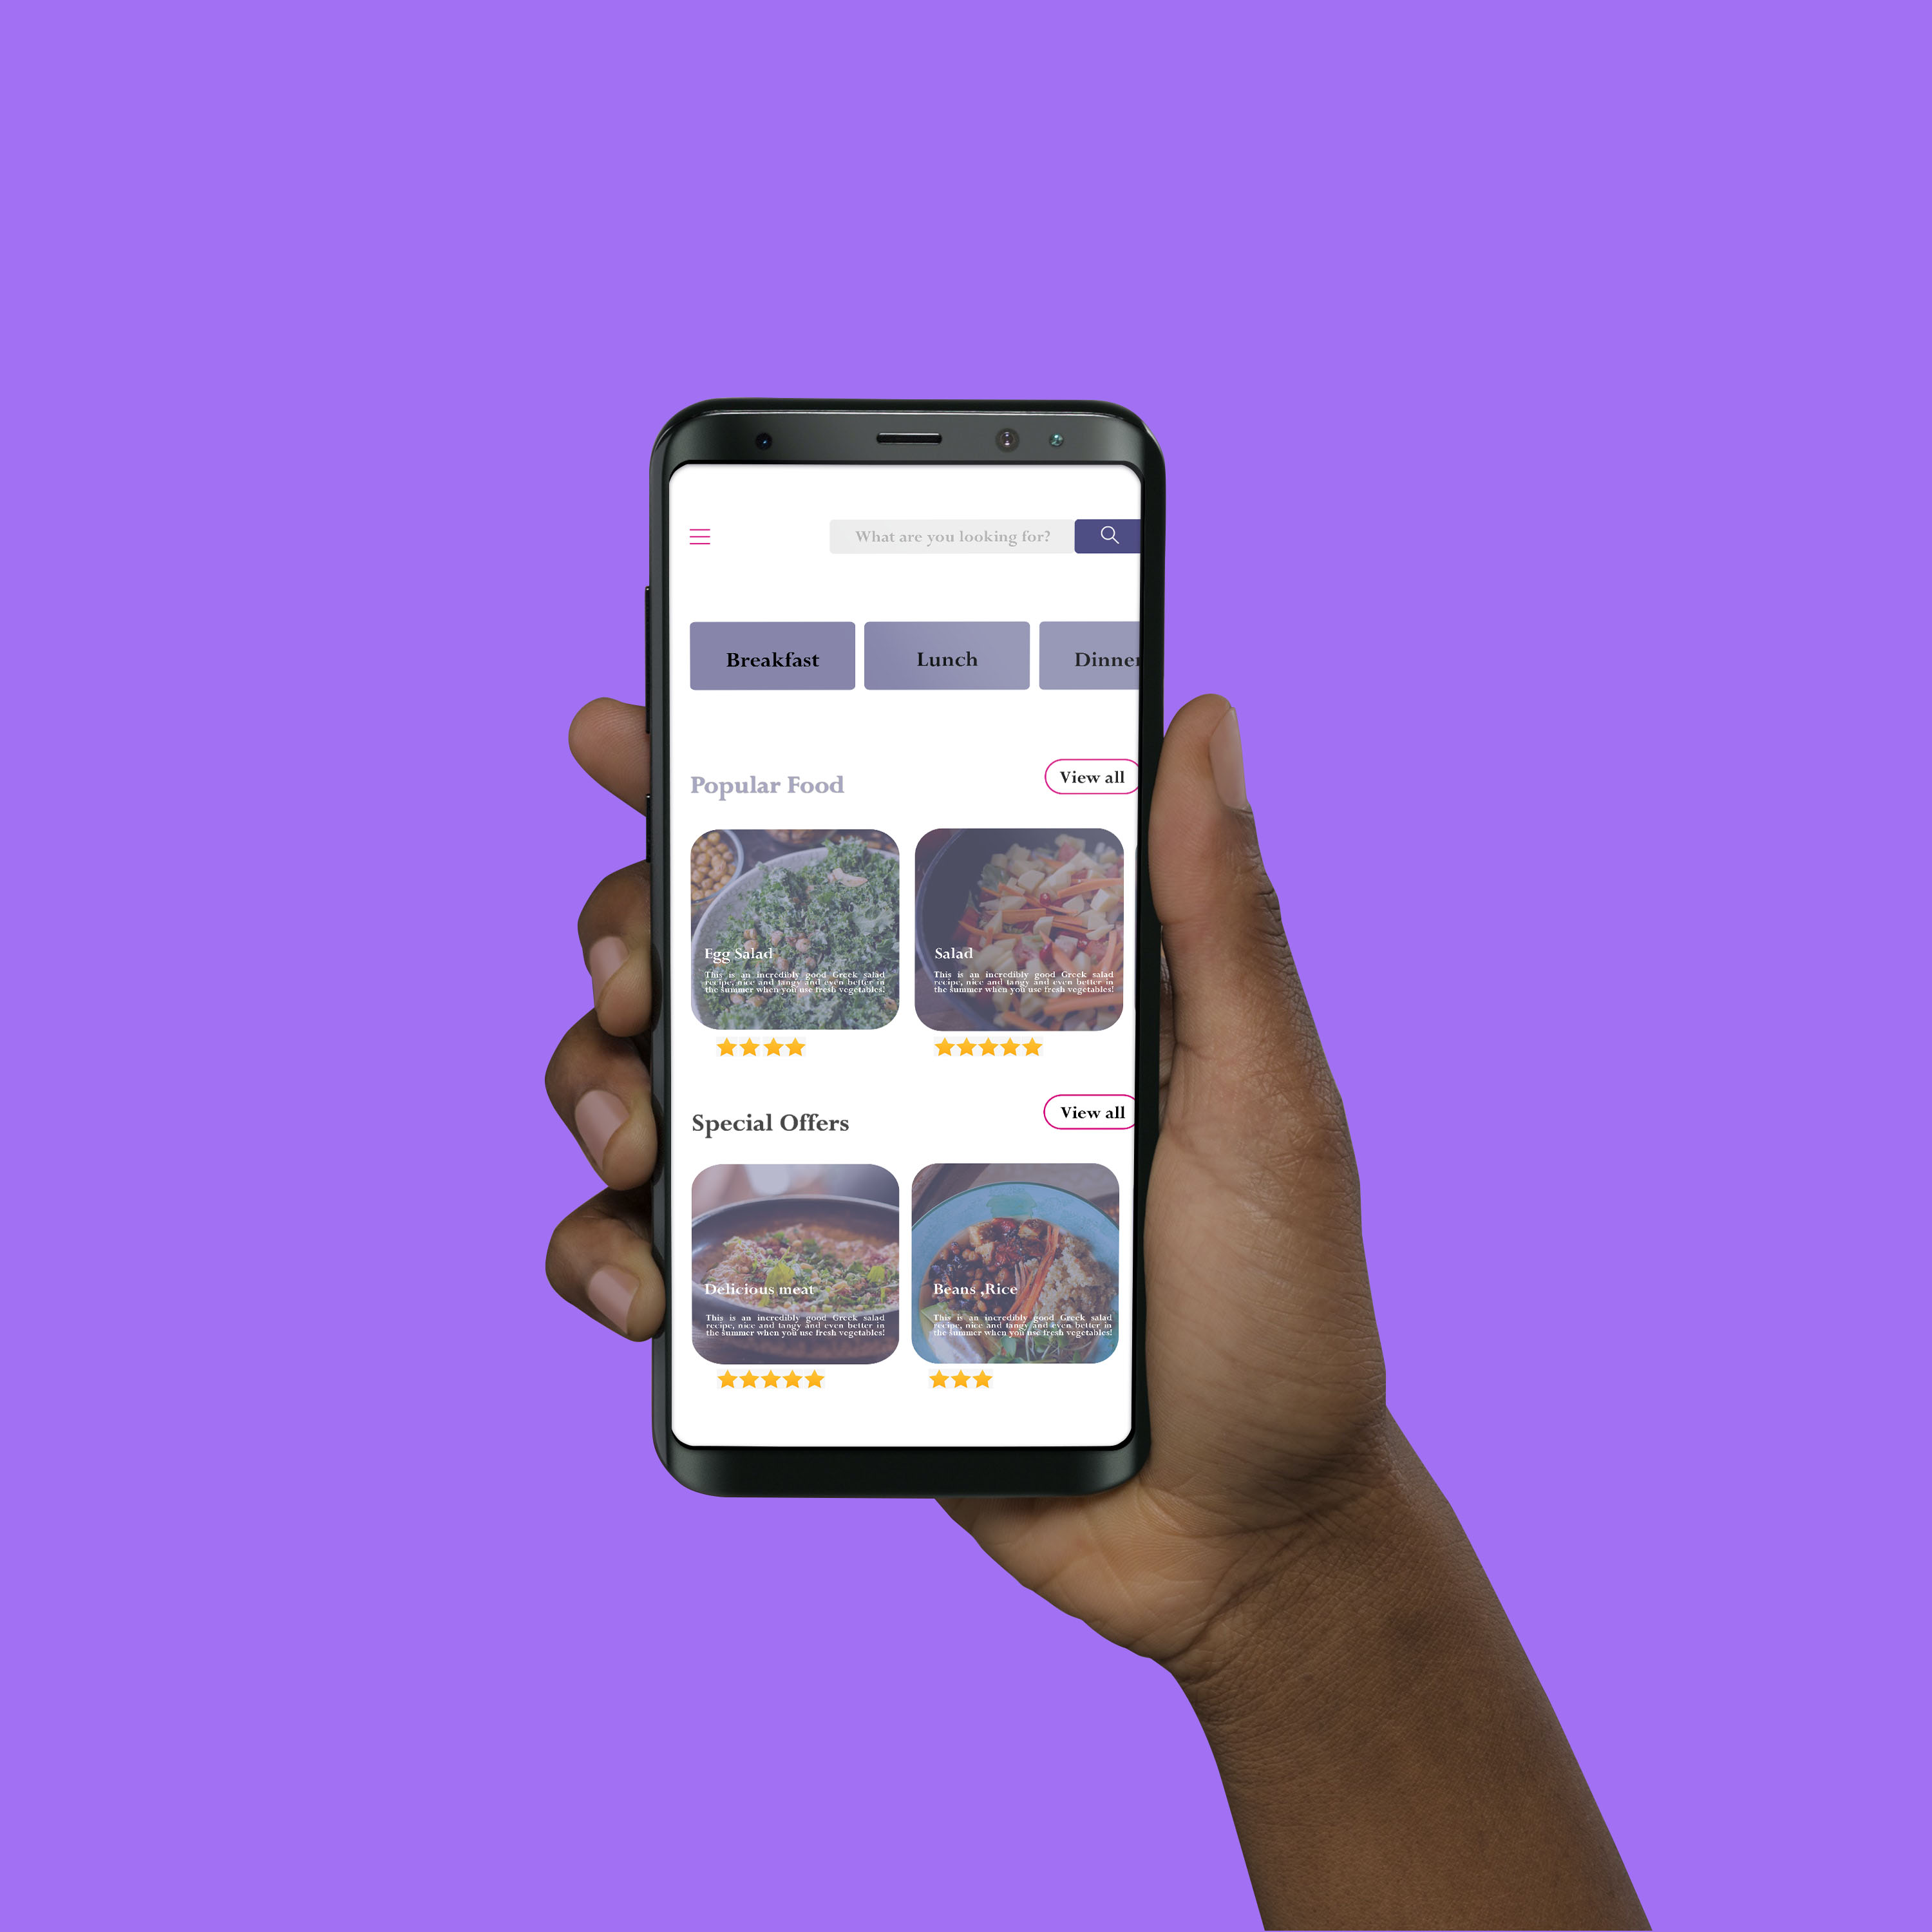
Aama app:
Main page menu:

